Slide 1
Tourette Syndrome
Is It a Laughing Matter?
  By Alexis Huefner, Brandon Peterson, Daniel Bye, Margrethe Montanares, and Sara Hare

Slide 2
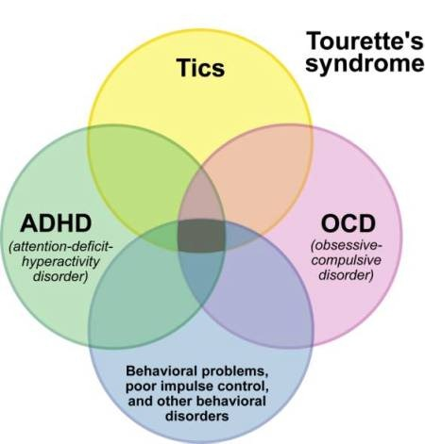
Introduction to Tourette Syndrome
Tourette syndrome (TS) is a neurological disorder characterized by repetitive, stereotyped, involuntary movements and vocalizations called tics
The disorder is named after Dr. Georges Gilles de la Tourette
An inherited neurological disorder

Slide 3
Introduction to Tourette Syndrome
3 in every 1,000 children of school age (6-17) have the disorder in U.S.
No two people with TS will have the same tics
Tics usually start around the age of 5 to 10 years old
Tics are usually worse during times of stress or excitement and improve with calm and focus
There is no cure for TS

Slide 4
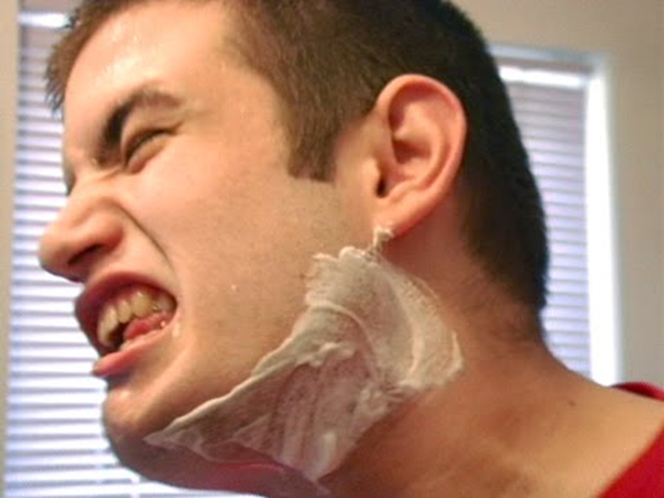
What is Tourette Syndrome?
A nervous system disorder involving repetitive movements or unwanted sounds
People are born with this syndrome affecting the nervous system in the brain
Many possible symptoms

Slide 5
Behavioral Symptoms
Repetitive movements
Involuntary imitation of someone else's movements
Meaningless repetition of own words or nonsense words
Lack of restraint, hyperactivity, or impulsivity
Swearing uncontrollably
Aggressive or compulsive behavior

Slide 6

Muscular Symptoms
Tics
Jerking muscle spasms
Involuntary movements
Difficulty with bodily movement
Involuntary muscle contraction
Increased muscle activity

Slide 7

Mood and Other Symptoms
Excitement
Apprehension or anxiety
Anger
Frequent throat clearing or stuttering
Eyelid twitching or repetitive blinking
Learning disability

Slide 8

Medicinal Prescription Treatments
Fluphenazine
Ziprasidone (Geodon)
Pimozide
Perphenazine
Haloperidol
Aripiprazole (Abilify)
Risperidone (Risperdal)

Slide 9

Receiving Help with Tourette Syndrome
Neurologist: Treats nervous system disorders
Psychiatrist: Treats mental disorders
Pediatrician: Provides medical care for infants, children, and teenagers

Slide 10

Living with Tourette Syndrome
Through the eyes of a comedian…
image courtesy of www.watchdocumentary.tv

Slide 11

A Particular Brand of Comedy
Comedian Samuel J. Comroe uses his disability as a source of comedy
He sees himself as he is; he does not try to hide his disability
image courtesy of laughstub.com

Slide 12
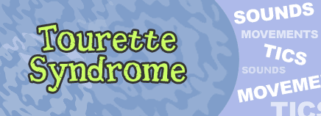
A Particular Brand of Comedy
He uses observational and self-deprecating humor to focus on his life with Tourette’s rather than hiding from it
Click the link below to see Samuel’s take on his disability
Samuel J Comroe on Conan - Twitchy Tourettes
image courtesy of kidshealth.org

Slide 13

The Early Years
Samuel was diagnosed with Tourette’s Syndrome in the third grade
Although his family was large and loving, school was hard for Samuel
He was teased and bullied throughout his early school years
image courtesy of youtube.com

Slide 14

High School
Samuel moved to a new school as a freshman and decided to be a new person
Instead of letting everyone laugh at him he laughed with them
This lead to his future as a stand up comedian
image courtesy of laffdown.com

Slide 15

Professional Life
Samuel started his career as a stand-up comedian early
During his junior year of high school, he got permission to do stand-up comedy in the school auditorium during lunch
He charged 50 cents per person and donated the proceeds to his class
image courtesy of preferredparkingcomedytour.com

Slide 16
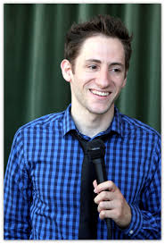
Professional Life
Samuel attended community college but soon decided that he wanted to be a comedian professionally
He became a regular at Flappers Comedy Club in Burbank, CA and continues to headline there today
He has won numerous comedy competitions, has been on national talk shows, and plays shows around the nation
image courtesy of tyoobe.com

Slide 17
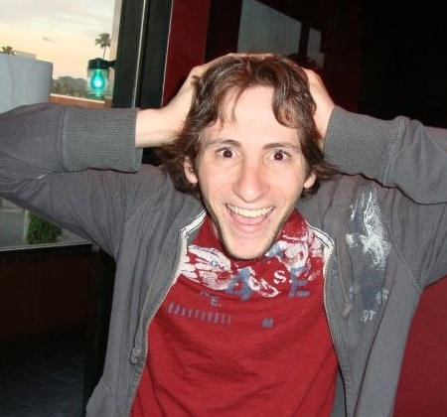
An Inspiration
The amazing thing about Samuel is his ability to take what, for many, is an embarrassing disability and turn it into a career
Some people might say that by making fun of himself, he is making light of a serious disease
image courtesy of qroquis.qronicle.net

Slide 18

An Inspiration
In reality he has adapted his environment to fit his needs and has created a life in which he is happy and successful
image courtesy of flappcast.com

Slide 19

What Did We Learn?
image courtesy of Stubhub.com

Slide 20
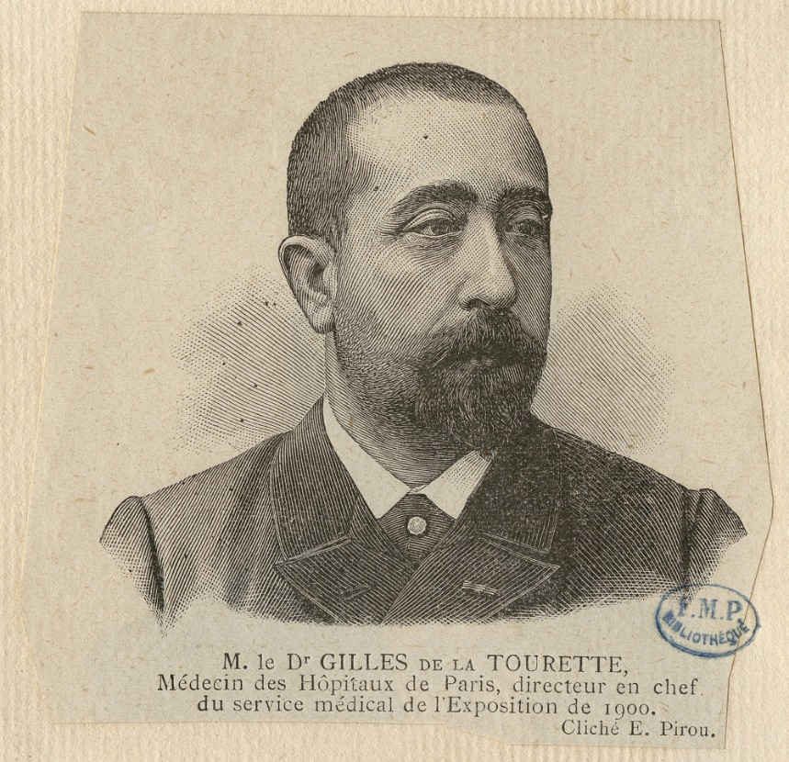
About People with Disabilities
People with disabilities sometimes have to embrace their differences rather than ignore them to live a full and happy life.
They are often stereotyped by society, which limits their opportunities in life.
image courtesy of wikipedia.org

Slide 21

About People with Disabilities
What society has labeled a “disability” can really be and extraordinary gift.
People with disabilities are often overlooked in our society, but all of them have something to offer, whether it's making others laugh or solving the mysteries of the universe.
image courtesy of www.nevadaddcouncil.org

Slide 22

About the Group Process
Group work can be difficult, especially online! But when everyone is striving to do their best things will get done.
Communication is much easier face to face. When organizing and working on a group project is limited strictly to digital media it is essential to have good, clear communication to avoid confusion.
image courtesy of Forbes.com

Slide 23

About the Group Process
Without clear goals and commitments, the group process can be quite frustrating, but once a dynamic is established, the varying personalities and strengths can be harnessed and utilized in great ways.
In the end what really mattered was that we all pulled our weight to create something good.
Image courtesy of trendsupdates.com

Slide 24

This Group’s Decision-Making
We used majority rules to make decisions. Suggestions were made and if everyone agreed, then it was chosen. We tried to discuss and give the option to discuss every aspect of the project before a decision was made.
image courtesy of Forbes.com

Slide 25

Conclusion
Tourette's Syndrome is a very serious neurological disease affecting about 0.3 % of the population. Ticks, muscle spasms, involuntary movements, uncontrollable swearing, aggressive behavior and lack of restraint are just a few of the symptoms that coincide with Tourette’s Syndrome. And there is no cure.
image courtesy of askmen.com

Slide 26

Conclusion
While this disease may seem like a life inhibiting disability, many people with Tourette’s syndrome are leading happy and successful lives. Even with the odds stacked against them, they have turned their condition from a disability into a strength. They aren’t held back by the limitations of an illness, but instead excel with it, and because of it.
image courtesy of healthresource4u.com

Slide 27

Conclusion
You must ask yourself:
Is Tourette Syndrome a laughing matter?
Perhaps Samuel J. Comroe answered that question for us.
image courtesy of quotesforest.com

Slide 28
References
125 Years of Tourette Syndrome. (2010). Retrieved February 9, 2015, from http://www.tsa-usa.org/Medical/history.html
20 facts about Tourette Syndrome you may or may not know. (2012). Retrieved February 9, 2015, from http://www.njcts.org/tsparents/20-facts-about-tourette-syndrome-you-may-or-may-not-know
Tourette Syndrome Fact Sheet. (2012). Retrieved February 13, 2015, from http://www.ninds.nih.gov/disorders/tourette/detail_tourette.htm
Comroe, Samuel J. (2012). Biography. Retrieved from http://samueljcomroe.com/newsite/about-me/

